Slide 1
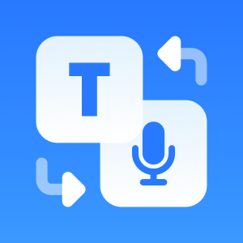
Text-to-Audio and Audio-to-Text Translation
By : Manawer Khaled Alanazi
1 / 10 / 2024

Slide 2

Outline:
Introduction
Objectives
Libraries Used
Code Explanation
How the Project Works
Challenges
Results and Benefits
Future Steps

Slide 3
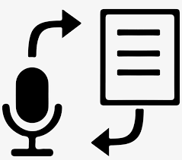
Introduction
What is the project?
A project for converting text to audio in both Arabic and English.
Converting audio to text using artificial intelligence.

Slide 4
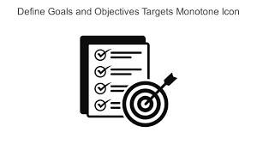
Objectives
Project Objectives:
Provide a tool for converting text between languages.
Enhance language learning and understanding through audio.

Slide 5
Libraries Used
Google Trans
Used for translating text between languages.
Why did I use it? It is user-friendly and supports many languages.
gTTS (Google Text-to-Speech)
Converts text to speech.
Why did I use it? It offers a variety of voice options and is easy to use.
Gradio
For creating an interactive user interface.
Why did I use it? It allows users to easily interact with the project.

Slide 6
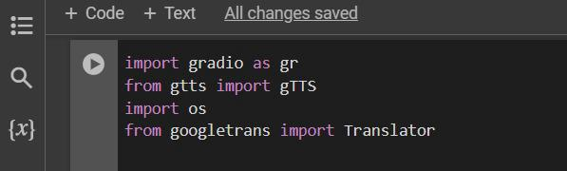
Code Explanation (Part 1)
Importing Libraries:
Explanation:
I import the required libraries.
gTTS is for text-to-speech conversion, and Translator is for translating text.

Slide 7
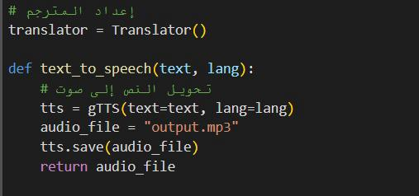
Code Explanation (Part 2)
Text-to-Speech Function:
Explanation:
This function takes a text and a language as inputs, then uses gTTS to generate an audio file.

Slide 8
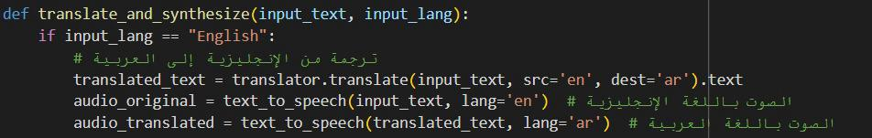
Code Explanation (Part 3)
Translation and Audio Function:
Explanation :
This function translates the text based on the input language, then creates two audio files (original and translated).

Slide 9
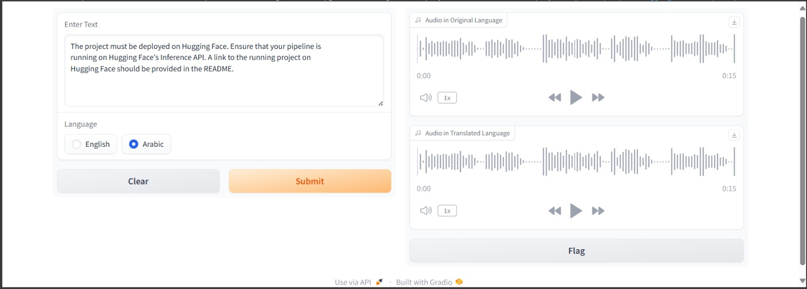
How the Project Works ?
User Interface:
I used *Gradio* to create a simple interface where users can input text, select a language, and listen to the generated audio.

Slide 10

Challenges
Challenges I faced:
Accuracy issues in translation.
Technical difficulties when working with libraries.

Slide 11

Results and Benefits
What have I achieved?
Successfully created a working project for text-to-speech conversion.
The project can be used for language learning and interacting with audio content

Slide 12


Future Steps
What’s next?
Improve translation accuracy.
Add new features such as speech recognition.

Slide 13



